Slide 1
Designing and Developing an Intelligent Multi-agent FRAMEWORK for Power System Control and Protection
Presented by:
Mr. Arangamanikkannan Manickam
Dept. of Computer Science, UWF
Guided by:
Dr. Thomas Reichherzer
Dr. Sukumar Kamalasadan
Dr. Sharon Simmons

Slide 2
Overview
Introduction and Scope
Hypothesis, Objectives and Proposed Methodology
Proposed Design
Extending the existing FIPA with Mutation & Intelligence for Power System Control and Protection
Effective and Secure Agent Communication by SSCP and DNP3
Proposed Features
Immediate Fault Restoration using Social ability of Agents
Intelligent Monitoring of power system using Wide Area Control (WAC)
Example Illustration
Application Area 1: Power System Control
Application Area 2: Power System Protection
Results
Conclusion
References

Slide 3
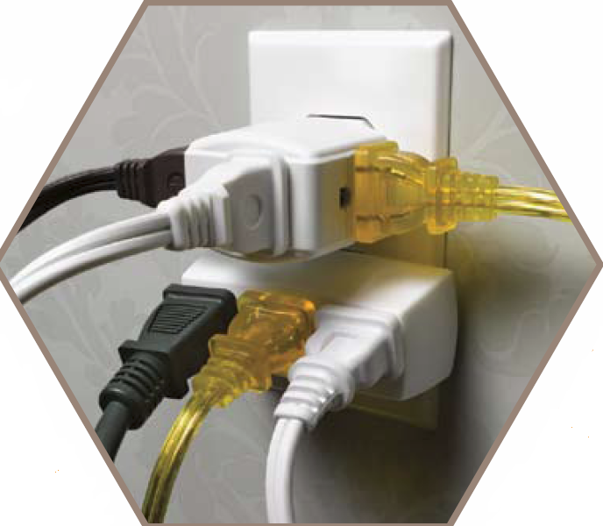


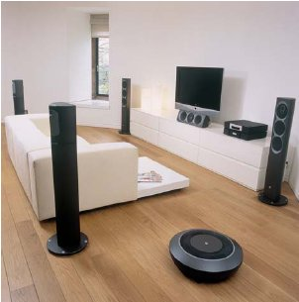

Introduction
Power is the need for everything.
Even few minutes of power outage will lead to the degradation a nation’s economy.
Power demand is now-a-days in peek because of population growth, bigger houses, etc,.
Since the usage of power is increased, the power system is getting complex which lead also the protection to be more complex.

Slide 4
Introduction: Power System outages
On 26 and 27 September, 2005, a cyber attack caused major disruptions affecting more than 3 million people in dozens of cities in the Brazilian state of Espírito Santo.
On July 12, 2004, two power plants in Lavrio and Megalopoli, Greece, shut down due to malfunction within 12 hours of each other, during a period of high demand (heat wave); that led to a cascading failure causing the collapse of the entire Southern (Power) System, affecting several million people in southern Greece
In January, 2007, a cyber attack knocked out power in three cities north of Rio De Janeiro, affecting tens of thousands of people.
On June 27, 2007, a power failure occurred in New York City. About 136,700 customers were without power during the height of the outage.

Slide 5
Introduction
Causes of Power System failure:
Faults at power stations
Damage to power lines, substations or other parts of the distribution system
A short circuit or overloading of electricity mains.
Cyber-attack to power system controllers
Power system control
Load balancing
Failure protection
What do we do?
We need someone sitting in each bus to monitor which is not possible.
Place agents in each node to monitor power system components and protect them.

Slide 6
Scope
To build an intelligent multi-agent system for power system control and protection
To protect the agents using two approaches
*Agent Replication by mutation
Securing the communication channel
To provide immediate fault restoration of the power system with Agent’s communication capability.
Ability of the Supervisory Agent Cluster to control all the generators (Wide Area Control)
*Already done by D. Edwards et al.

Slide 7
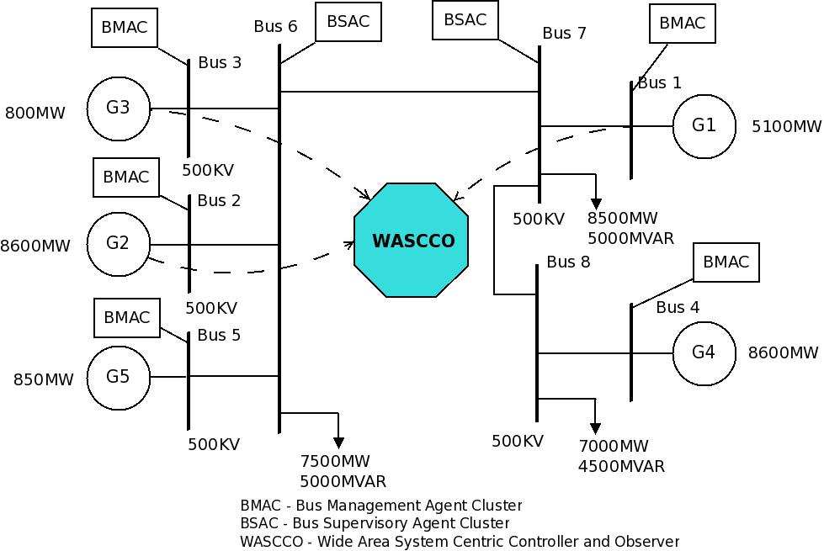
Proposed Design

Slide 8
PROPOSED DESIGN
BMAC/BSAC consists of MAM, AMS and DF.
AMS and DF are two special purpose agents.
AMS – maintains list of all other agents present in the system.
DF – maintains a list of services provided by all other agents present in the system.
MAM consists of intelligent agents which are used to monitor, control and protect the system.

Slide 9
PROPOSED DESIGN: Bmac - flowchart
START BMAC
Extensibility
If neighbour/ BSAC asking for info
Get parameters from power system components
No
Ask each neighbor about the status
Yes
No
If Abnormal
Send Info
Analyse
If Abnormal
No
Yes
Inform BSAC
Yes
Perform action for the command from BSAC
Inform BSAC

Slide 10
PROPOSED DESIGN: BSac - flowchart
Start BSAC
Get status from BMAC
Enter log
Yes
If info about neighbors
Terminate & Restart
No
Contact the neighbor of the sending BMAC
Send a command to the BMAC with sufficient power

Slide 11
PROPOSED DESIGN - Features
Attributes | Description
Reactivity | ability to react to changes.
Pro-activeness | goal directed behavior.
Social ability | ability to communicate with other agents.
Flexibility | respond to dynamic situations.
Extensibility | dynamically add new functions.
Fault tolerant | mutation and agent intelligence.

Slide 12
BMAC
Monitoring is done by Bus Monitoring Agent Cluster (BMAC).
BMAC monitor the power system parameters (generator voltage, Generator speed, etc.) and communicate it with BSAC in a secure manner.

Slide 13
BMAC- Architecture
BMAC
AMS
DF
MAM
Communication Agent
Mutation Agent
Monitoring/ Resurrection Agent
Distributed / Voting Agent
Agent
Agent
Agent

Slide 14
BMAC - Implementation
Implemented in C.
Initially Monitoring/Resurrection agent is started.
Monitoring/Resurrection agent then starts all other agents in MAM, AMS and DF and also mutates the replicated agents from the source code.
Both intra-network and inter-network communication takes place through communication agent.
Since we have more replicated agents in the system, any fault occurred is immediately informed to the supervisor and the communication is reliable.

Slide 15

BSAC architecture
Supervision of BMAC is done by Bus Supervision Agent Cluster (BSAC).
The architecture and implementation of BSAC is similar to BMAC except ;
No. of replicated agents are more.
The communication between supervisory level agents and between supervisory level agents and monitoring agents should be secure.
Secure SCADA Communications Protocol (SSCP) and DNP3 can be used.
BSAC
BMAC/ BMAC
SSCP + DNP3

Slide 16
BSAC
BSAC obtains electrical parameters from the bus and also from all the BMACs in its area.
With all the parameters, easy to find fault in power system.
In case of failure, it is easy to find out node with sufficient power
Also, it inputs all the parameters Wide area control (WAC) neural network and sends out the control signal to each individual generators by their BMAC

Slide 17
Effective Agent Communication
Message Field | Description
Performative | Type of communicative act
Sender | Participant in communication
Receiver | Participant in communication
Reply-to | Participant in communication
Content | Content of message
Language | Content language
Encoding | Encoding of content
Ontology | Ontology used
Protocol | Protocol for conversion
Conversation-id | ID for conversation control
Reply-with | Conversation control parameter
In-reply-to | Conversation control parameter
Reply-by | Conversation control parameter
Figure shows FIPA-ACL structure.
The “performative” field is mandatory.
The content of a message comprises two parts: content language and ontology.
The content language defines syntax, or grammar, of the content. The semantics or lexicon is drawn from the ontology.
Example Message format
Agent - A
Agent - B
FIPA - SL
Performative
Sender
Receiver
Content
Language
…
Query
isCircuitBreakerOpen()

Slide 18
Effective Agent Communication
We use FIPA-SL (FIPA – Semantic Language)
Upper ontology of power system defines all basic attributes needed for a power system. We derive attributes for our control and protection domain from this base ontology.
SSCP/DNP3 adds security to our communication.
Upper ontology for power systems
Ontology for specific Monitoring & Diagnostic Application
Ontology for specific Protection Application
Ontology for specific Distributed Control Application
Ontology for specific Modeling and Simulation Application

Slide 19
Security
Security is provided in two aspects.
Mutation – Monitoring agent is monitoring all the agents activities and terminates the agent if it is malfunctioning, responding slowly or not responding.
Communication Security
Secure SCADA Communications Protocol.
HMAC for Message digest
Diffie-Hellman for Key Exchange
DNP3 for data transfer

Slide 20
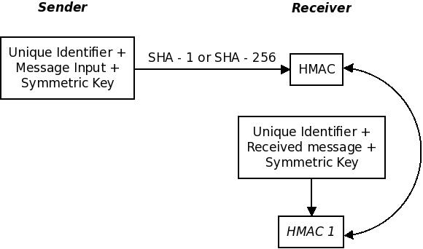
Security - sscp

Slide 21
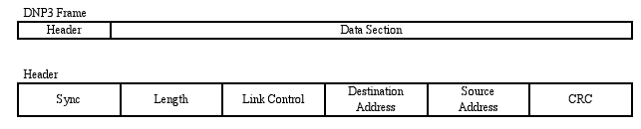
Security – dnp3
DNP3 provides
Link layer responsibility
Addressing
CRC checks
Link layer confirmation

Slide 22
Wide Area system centric controller and observer (WASCCO) in BSAC
A wide-area neural network module is placed in the Supervisory agent (BSAC).
It obtains the information from all outstation agents (BMACs)
WASCCO is trained to detect abnormal conditions in the power system
A control signal is sent to the outstation which regulates the speed of the generators

Slide 23
WASCCO
W1
WASCCO
ΔV1
Vt1
W2
ΔV2
Vt2
W3
ΔV3
Vt3
Other ctrl signals
G_{i}
Add
ΔVi
Exciter

Slide 24
WASCCO - DESIGN
Plant
P_{k}^{n} (w, Vt)
Action
P_{k-1}^{n} (w, Vt)
TDL
TDL
P_{k-2}^{n} (w, Vt)
P_{k}^{n} (w, Vt, ctrl)
WANNID
W_{k}^{n} (w, Vt)
P_{k-1}^{n} (w, Vt, ctrl)
A_{k} (ctrl)
TDL
TDL
TDL
TDL
W_{k-1}^{n} (w, Vt)
W_{k-2}^{n} (w, Vt)
P_{k} – Plant output at time ‘k’
A_{k} - Action output at time ‘k’
W_{k} – WANNID output at time ‘k’
C_{k} - Critic output at time ‘k’
Critic
C_{k}^{n} (w, Vt)

Slide 25
WADCCO – DESIGN…
Enhancing utility function including the following
power
MRAC control signal
Lambda Backtracking
More effective learning method
(1-λ) + (1- λ) λ + (1- λ) λ² + . . .
Up to ‘n’ steps
Weight = λ^{n-1}
Prioritizing values
Integrating with local controllers
k*U_{nn}+(1-k)*U_{local}

Slide 26
Example Illustration
150/20 kV
BMAC
4
BMAC
BMAC
2
150/20 kV
150/20 kV
BSAC
6
1
G
BMAC
BMAC
7
3
150/20 kV
150/20 kV
BMAC
5
150/20 kV

Slide 27
Example Illustration
All the agents in all the buses are started running.
Periodic communication between BMAC and BSAC are done.
If a fault occurs and is identified by the agent in that node, it will inform the BSAC.
If an agent finds a fault in the neighbor node by periodic communication, it will inform the BSAC immediately and necessary action will be taken.

Slide 28
Example Illustration – Faulty Conditions – Case 1
150/20 kV
BMAC
4
BMAC
BMAC
2
150/20 kV
150/20 kV
BSAC
3 MW
6
1
4 MW
G
6 MW
BMAC
BMAC
7
3
150/20 kV
150/20 kV
6 MW
9 MW
BMAC
5
150/20 kV
fault

Slide 29
Example Illustration – Faulty Conditions – Case 1
Reactive
150/20 kV
BMAC
4
BMAC
BMAC
2
150/20 kV
150/20 kV
BSAC
3 MW
6
1
4 MW
G
6 MW
BMAC
BMAC
7
3
150/20 kV
150/20 kV
6 MW
9 MW
BMAC
5
150/20 kV
fault

Slide 30
Example Illustration – Faulty Conditions – Case 1
150/20 kV
BMAC
4
BMAC
BMAC
2
150/20 kV
150/20 kV
BSAC
3 MW
6
1
4 MW
G
6 MW
BMAC
BMAC
7
3
150/20 kV
150/20 kV
Social ability
6 MW
9 MW
BMAC
5
150/20 kV
fault

Slide 31
Example Illustration – Faulty Conditions – Case 1
150/20 kV
BMAC
4
BMAC
BMAC
2
150/20 kV
150/20 kV
BSAC
3 MW
6
1
4 MW
G
6 MW
BMAC
BMAC
7
3
150/20 kV
150/20 kV
6 MW
9 MW
BMAC
5
150/20 kV
fault

Slide 32
Example Illustration – Faulty Conditions – Case 2
Intruder
150/20 kV
BMAC
4
A1
A2
A3
BMAC
BMAC
2
150/20 kV
150/20 kV
BSAC
6
1
4 MW
G
6 MW
BMAC
BMAC
7
3
150/20 kV
150/20 kV
9 MW
BMAC
5
150/20 kV

Slide 33
Example Illustration – Faulty Conditions – Case 2
Intruder
Fault tolerant
150/20 kV
BMAC
4
A1
A2
A3
A3`
BMAC
BMAC
2
150/20 kV
150/20 kV
BSAC
6
1
4 MW
G
6 MW
BMAC
BMAC
7
3
150/20 kV
150/20 kV
9 MW
BMAC
5
150/20 kV

Slide 34
Example Illustration – Faulty Conditions – Case 3
150/20 kV
BMAC
4
BMAC
BMAC
2
150/20 kV
150/20 kV
BSAC
6
1
4 MW
G
6 MW
BMAC
BMAC
7
3
150/20 kV
150/20 kV
9 MW
BMAC
5
150/20 kV

Slide 35
Example Illustration – Faulty Conditions – Case 3
150/20 kV
BMAC
4
BMAC
BMAC
2
150/20 kV
150/20 kV
BSAC
6
1
4 MW
G
6 MW
BMAC
BMAC
7
3
150/20 kV
150/20 kV
9 MW
BMAC
5
Social ability
150/20 kV

Slide 36
Example Illustration – Faulty Conditions – Case 3
150/20 kV
BMAC
4
BMAC
BMAC
2
150/20 kV
150/20 kV
BSAC
6
1
4 MW
G
6 MW
BMAC
BMAC
7
3
150/20 kV
150/20 kV
9 MW
BMAC
5
150/20 kV

Slide 37
Example Illustration – Faulty Conditions – Case 3
150/20 kV
BMAC
4
BMAC
BMAC
2
150/20 kV
150/20 kV
BSAC
6
1
4 MW
G
6 MW
BMAC
BMAC
7
3
150/20 kV
150/20 kV
9 MW
BMAC
5
150/20 kV

Slide 38
Example Illustration – Communication
150/20 kV
BMAC
4
BMAC
BMAC
2
150/20 kV
150/20 kV
BSAC
6
1
4 MW
G
6 MW
BMAC
BMAC
7
3
150/20 kV
150/20 kV
9 MW
BMAC
5
150/20 kV
isCircuitBreakerOpen(BRKi)

Slide 39
Example Illustration – Communication
150/20 kV
BMAC
4
BMAC
BMAC
2
150/20 kV
150/20 kV
BSAC
6
1
TRUE
4 MW
G
6 MW
BMAC
BMAC
7
3
150/20 kV
150/20 kV
9 MW
BMAC
5
150/20 kV
isCircuitBreakerOpen(BRKi)

Slide 40
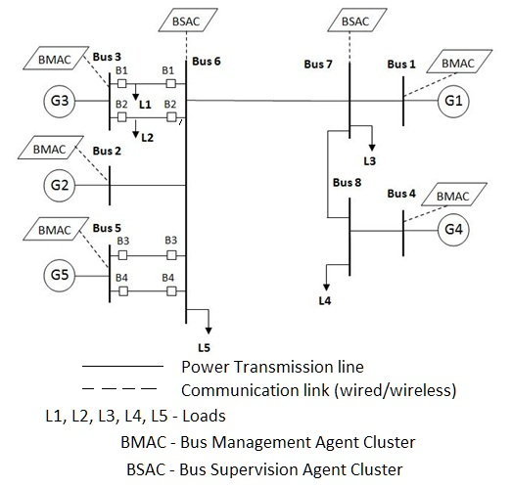
TESTING on a two-area system
At t=2, fault simulated at Gen 3
At t=5, B1 opens → L1 left unpowered
At t=10, B2 opens → L1 and L2 left unpowered → BMAC restores power by communicating with BSAC
At t=10.1, Power restored and generator 3 isolated.
At t=15, B1 and B2 closed to simulate fault restoration → reported to BSAC and generator 3 included to the system

Slide 41
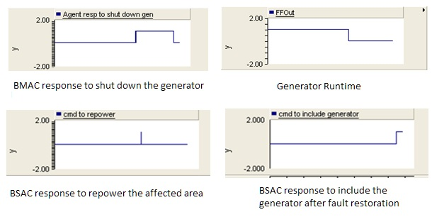
Results – agent communication (Case 1)

Slide 42
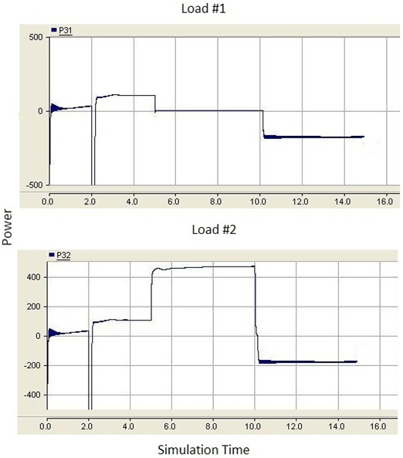
Results – agent communication

Slide 43
TIME EXPERIMENT
Agent | Time (mS)
Bootstrapping | 34,000
RCA | 0.37
DVA | 0.97
AMS | 0.43
DF | 0.4
CA | 1.83
Turnaround Time | 399
BSAC response time | 649
Bootstrap – Time taken to initialize all the agents
Turnaround time – Time taken between sending the electrical parameters to BMAC and receiving a response signal
BSAC response time – Time taken by the BSAC to process the received report, communicate with other BMACs and to send the response signal.

Slide 44
Time diagram for a single bmac/bsac
Init/Resurrect
Waiting for data
Data processing
DF query
AMS query
MRA
MA
MA starts each agent
Agent registrations
CA
DVA
AMS
DF
RCA1
RCA2
RCA3
Time

Slide 45
Time diagram for overall system
Communicate with BMAC1 neighbors and send response
Report Handling
Normal update
BSAC
Knowledge Exchange
Send Report
Process BSAC response
BMAC1
Process&Respond
BMAC2
Respond to BSAC message
BMAC3
Time

Slide 46
Project completion chart
Action and Critic Enhancements
Agent platform creation for a single node with mutation
Adding AMS and DF -> BMAC
Training of Action and Critic Neural Network (online)
Test it with a single node
Training of Model Neural Network (offline and online)
IEEE PES GM 2010
Initiation of Wide Area System Centric Controller and Observer (WASCCO)
Replicated Agent clusters in all nodes of two area power system
Add communication capability to all BMACs
Test this IMF for immediate fault restoration
Test communication and Querying capability of AMS and DF
IEEE CICS 2011
Build ontology for content language for reporting and responding -> Intelligent Multi-agent Framework (IMF)
Implementation of BSAC and placing in buses 6 and 7

Slide 47
To do:
Wide Area Monitor/Controller
Action normalization
Action training
Check Utility function to include
Power
MRAC
Lambda backtracking – paper 227
Study carious scenario and compare results
Test it between
DHP
Small NN
MRAC/PSS
Test Value priority (Book chapter 6362 and paper 1029)
Placement of WASCCO in BSAC and test it on a two-area network with 8-bus
Security with Wide-area controller (SSCP + DNP3 protocol)
Experimental Results

Slide 48
Implementation schedule
To-do | Procedure | Reference | Deadline | Done?
Action Normalization | - | - | - | Yes
Training the Action Network | Feeding plant outputs and PSS output to act like a PSS | Dr. Kamalasadan/ Literature | December 22 | No
Enhancing Utility Function | Adding additional control signals/Power parameters | Dr. Venayagamoorthy/ Literature | December 27 | No
Lambda backtracking | (1-λ) + (1- λ) λ + (1- λ) λ² + . . . | Paper 0227/ Literature | January 1 | No
Value priority | Prioritizing control signals | Book Chapter 6362/ Literature | January 8 | No
Integrating with local controllers | Take the value priority outputs and add (K*Unn+(1-K)*Ulocal | Dr. Kamalasadan/ Literature | January 10 | No
Integrating with BMAC and BSAC | Get the signal from Wide Area BSAC and perform control action | Dr. Kamalasadan/ Literature | January 18 | No
Developing JADE and FIPA architecture |  | Dr. Kamalasadan/ Literature | January 24 | No
Developing Test Cases |  | Dr. Kamalasadan/ Literature | January 31 | No
Thesis Writing |  |  | Feb 1- Feb 20 | No

Slide 49
Conclusion
An Intelligent Multi-agent Framework (IMF) is proposed.
The framework is able to control and protect the power system.
Fault area isolation is done without affecting un-faulted area.
Degree of fault tolerance is increased by mutation.
Wide area coordinating system centric controller controls all the generators effectively.
Mutation and Communication security makes the agent awake all the time

Slide 50
References
[1] Ni Hui, G.T. Heydt, L. Mili,”Power system stability agents using robust wide area control,” IEEE Transactions on Power Systems,” vol 17, Issue 4, Nov. 2002 Page(s):1123 - 1131
[2] Stephen D. J. McArthur, Member, IEEE, Scott M. Strachan, and Gordon Jahn “The Design of a Multi-Agent Transformer Condition Monitoring System”, IEEE Transactions on Power Systems, vol. 19, no. 4, November 2004.
[3] E. M. Davidson, S. D. J. McArthur, J. R. McDonald, T. Cumming, and I. Watt, “Applying multi-agent system technology in practice: Automated management and analysis of SCADA and digital fault recorder data,” IEEE Trans. Power Syst., vol. 21, no. 2, pp. 559–567, May 2006.
[4] S. D. J. McArthur, S.M. Strachan, and G. Jahn, “The design of a multiagent transformer condition monitoring system,” IEEE Trans. Power Syst., vol. 19, no. 4, pp. 1845–1852, Nov. 2004.
[5] V. M. Catterson, E. M. Davidson, and S. D. J. McArthur, “Issues in integrating existing multi-agent systems for power engineering applications,” in Proc. 13th Int. Conf. Intelligent Systems Application to Power Systems, 2005.
[6] Ke Wang, Salvatore, “Anomalous Payload-based Network Intrusion Detection”, Recent Advance in Intrusion Detection (RAID), Sept. 2005.

Slide 51
References
[7] Devi parikh, Tsuhan Chen, “Data Fusion and Cost Minimization for Intrusion Detection”, IEEE transactions on Information Forensics and Security, vol. 3, no.3, Septemer 2008.
[8] Ciza Thomas, N. Balakrishnan, “Improvement in Intrusion Detection With Advances in Sensor Fusion”, IEEE transactions on Information Forensics and Security, vol. 4, no.3, September 2009.
[9] Michael and Anup Ghosh, “Simple, State-Based Approaches to Program-Based Anomaly Detection”, ACM transactions on Information and System Security, vol. 5, no. 3, August 2002, pp. 203-237.
[10] Daniel S. Fava, Stephen and Yang, “Projecting Cyberattacks Through Variable-Length Markov Models”, IEEE transactions on Information Forensics and Security, vol. 3, no. 3, September 2008.
[11] Abhishek Das, David, Joseph, Gokhan and Alok, “An FPGA-Based Network Intrusion Detection Architecture”, IEEE transactions on Information Forensics and Security, vol. 3, no.1, March 2008.

Slide 52

Thank you…
Any questions???

Slide 53

Power System Control - Communication Agent
Start
Notify MRA that it is up
It is responsible for communicating with the bus and other agents in the power system network.
Communicate with Bus/Other agents
Validate incoming data
No
If Normal
Ignore the data
Yes
Communicate with DVA and send the data back

Slide 54
Power System Control - Mutation Agent
START
READ SOURCE CODE
This agent performs the mutation and loads the replicated agent code in memory.
MUTATE THE SOURCE CODE
COMPILE THE MUTATION
EXECUTE
STOP

Slide 55
Power System Control - Monitoring/Resurrection Agent
Start
Create and start CA, DVA, RCA
It does the initial mutation and monitors all the agents and gives re-birth if anything fails.
Monitor all the modules
If attacked
No
Yes
Remove compromised module
Rebuild and start the new module
Join new module to remaining agents

Slide 56
Power System Control - Distributed/Voting Agent
Start
Notify MRA that it is up
This agent is responsible to get rid of the abnormal behavior of agents. It is also a bridge between communication agent and replicated agents.
Obtain data from CA
Validate incoming data
If Normal
No
Ignore data
Yes
Send a copy to each RCA
Get data from all RCA
Vote
Send output to CA

